Slide 1
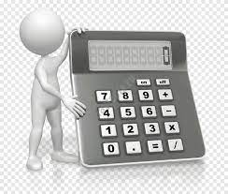
VOICE ASSISTANT
CALCULATOR
NATURAL LANGUAGE PROCESSING PROJECT
BY:
NAZIYA KHALID &
JYOTSNA MISHRA

Slide 2
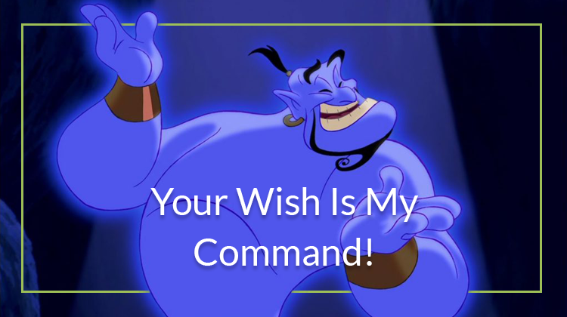

VOICE ASSISTANT??
It's software that carries out everyday tasks via voice command.
It's brings AI and machine learning together to recognize our voice and do what we ask it.

Slide 3


WHAT OUR PROJECT IS ALL ABOUT?
We have made a smart scientific calculator using Python, with Tkinter used for the front end.
This will perform different mathematical calculations through voice commands.
Voice Assistant Calculator

Slide 4


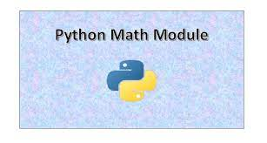



Modules Used
Here we will discuss the different modules that we have implemented in our project
This Photo by Unknown Author is licensed under CC BY-SA

Slide 5
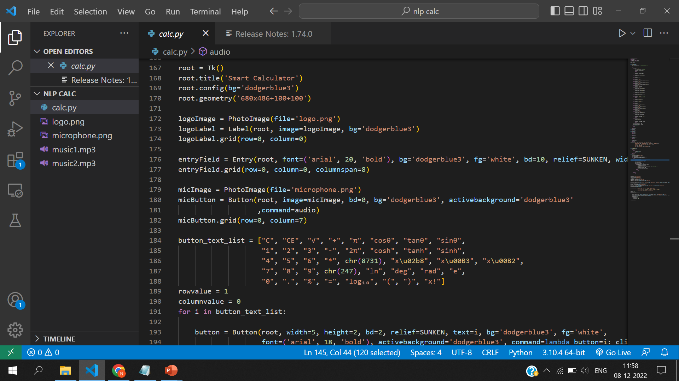
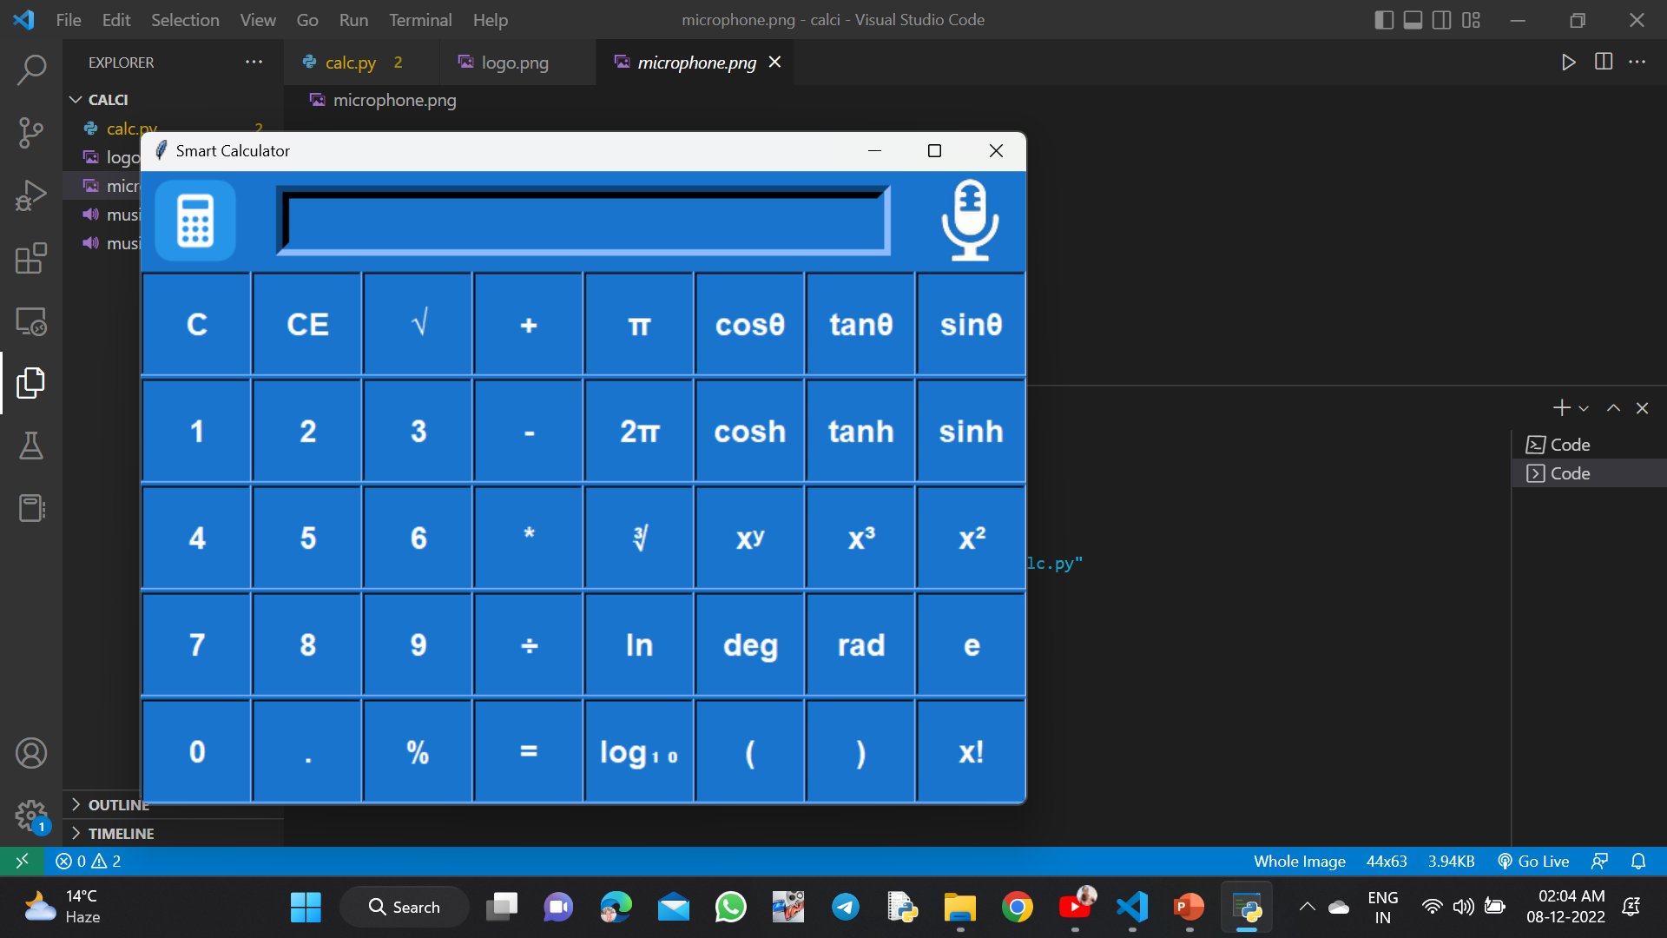
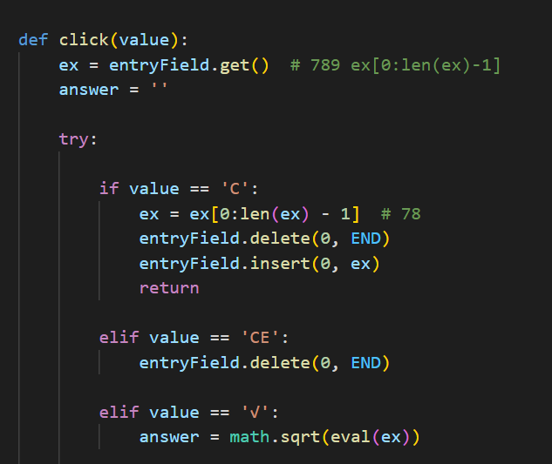
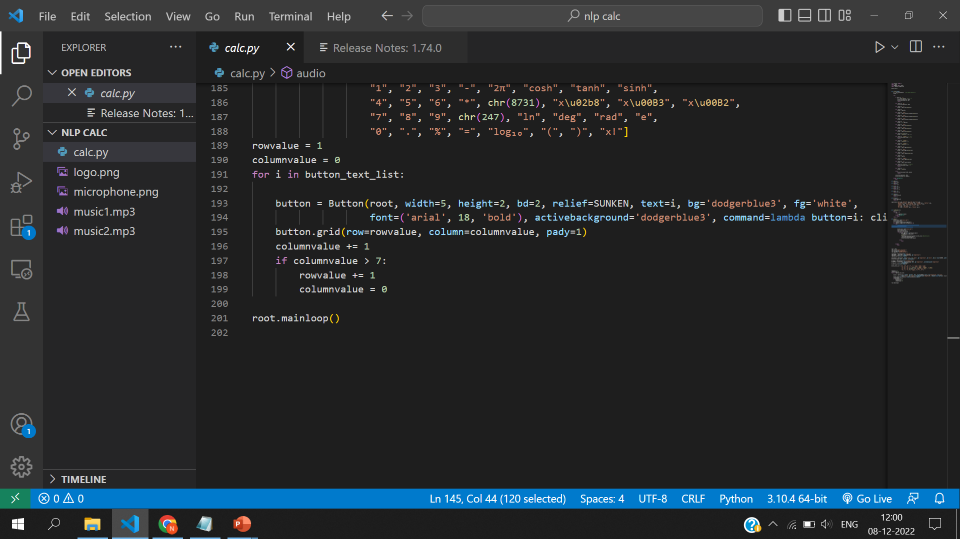
GUI

Slide 6
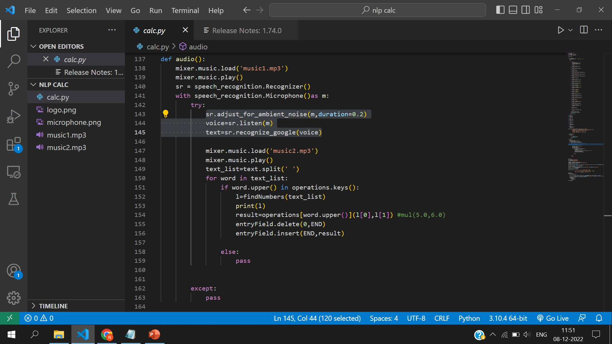
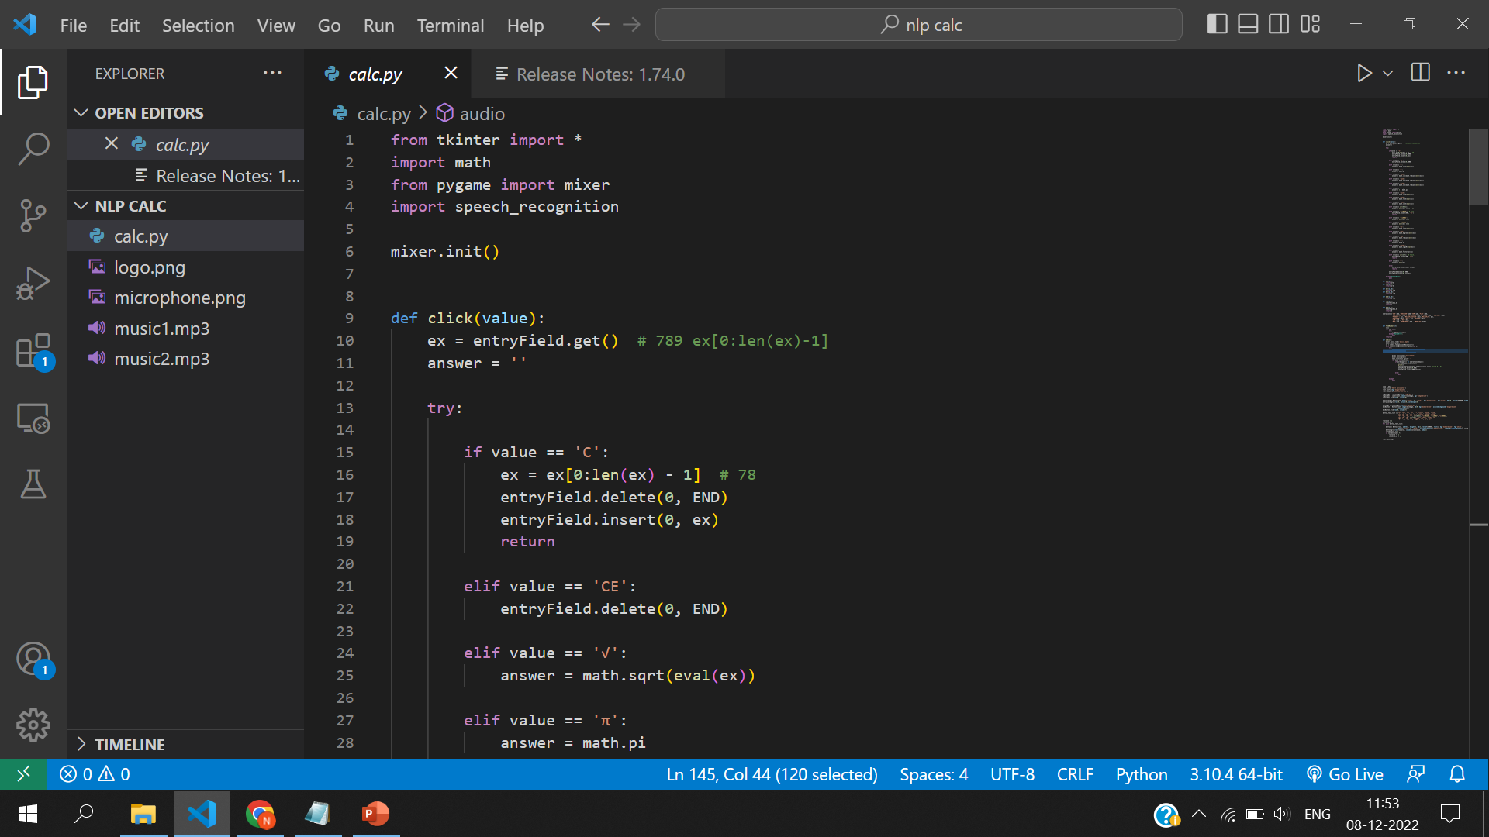
Speech recognition

Slide 7
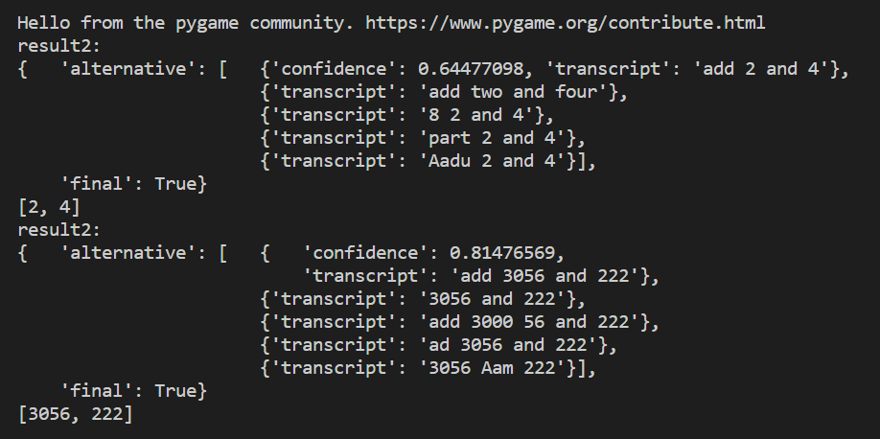
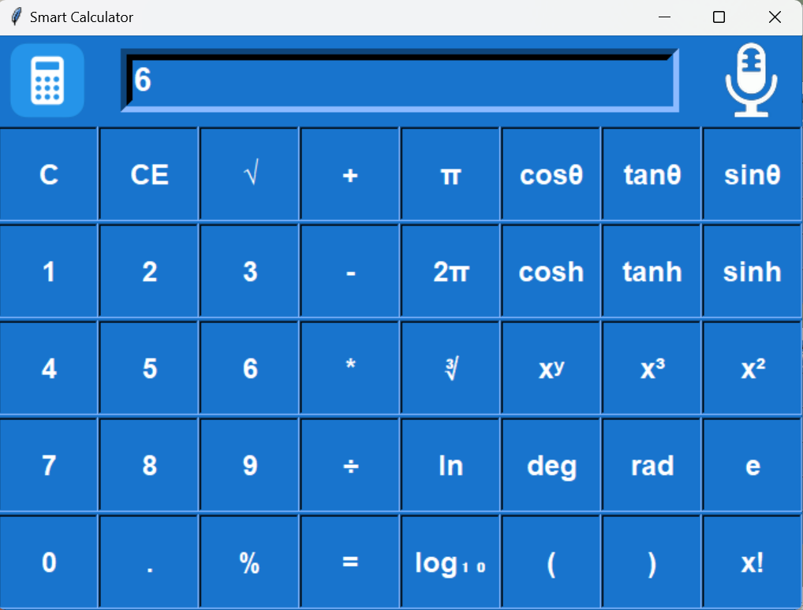
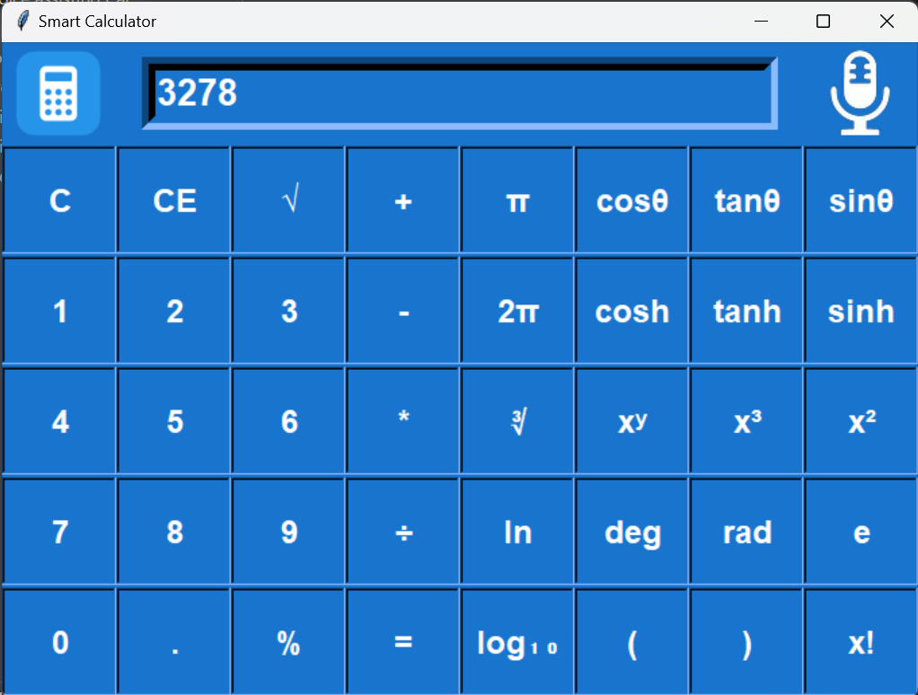
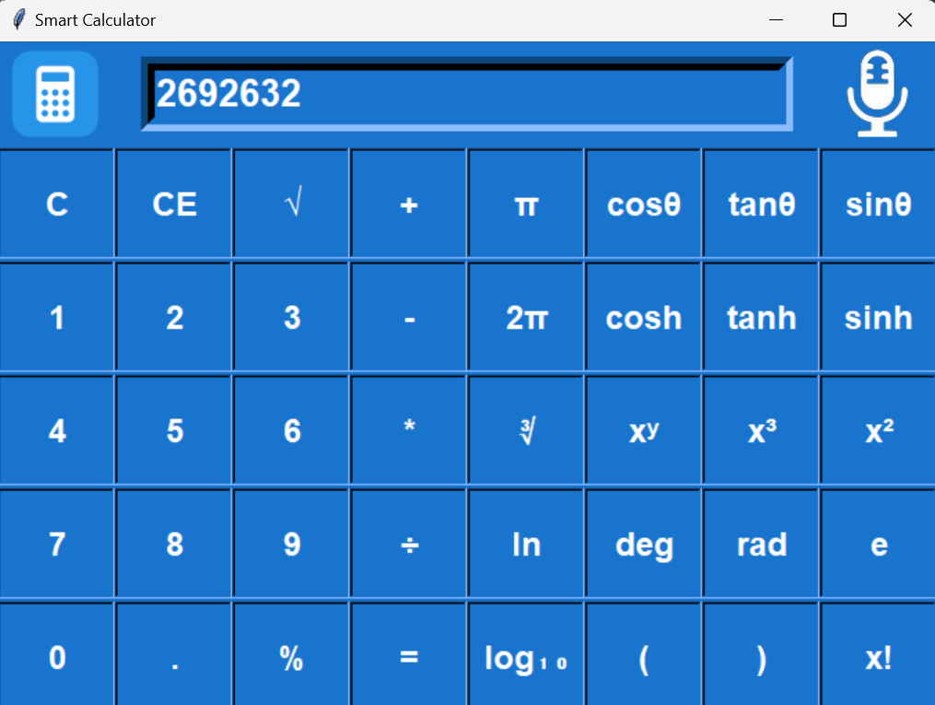
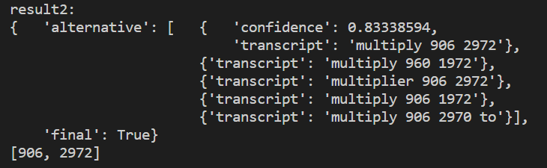
Input Screen
Output Screen

Slide 8



